Slide 1
Sticks
Uva 307
Time: 3 seconds

Slide 2
Problem Descriptions
George took sticks of the same length and cut them randomly until all parts became at most 50 units long.
Now he wants to return sticks to the original state, but he forgot how many sticks he had originally and how long they were originally. Please help him and design a program which computes the smallest possible original length of those sticks. All lengths expressed in units are integers greater than zero.

Slide 3
Input
The input file contains blocks of 2 lines.
The first line contains the number of sticks parts after cutting.
The second line contains the lengths of those parts separated by the space.
The last line of the file contains ‘0’.

Slide 4
Output
The output file contains the smallest possible length of original sticks, one per line.

Slide 5
Sample Input / Output
number of sticks after cutting
Lengths of sticks
9
5 2 1 5 2 1 5 2 1
4
1 2 3 4
0
6
5
5 2 1 5 2 1 5 2 1
End of test cases
1 2 3 4

Slide 6
Solution
Sticks: 5 2 1 5 2 1 5 2 1
sum=5+2+1+5+2+1+5+2+1=24
sorting: 5 5 5 2 2 2 1 1 1
ans = from 5 to sum/2=12 列舉所有可能
Additionally, (sum%ans==0)

Slide 7
Solution
sticks:
sum=5+2+1+5+2+1+5+2+1=24
sorting:
ans = from sticks[0]=5 to sum/2=12 列舉所有可能
Additionally, (sum%ans==0)
可能的答案只有: 6 8 12
0 | 1 | 2 | 3 | 4 | 5 | 6 | 7 | 8
5 | 2 | 1 | 5 | 2 | 1 | 5 | 2 | 1
0 | 1 | 2 | 3 | 4 | 5 | 6 | 7 | 8
5 | 5 | 5 | 2 | 2 | 2 | 1 | 1 | 1
從小到大檢查

Slide 8
Recursive Solve
第幾根 stick
需裁減的長度
總長剩下多少
solve ( i , l , remain)
array “used”
0 | 1 | 2 | 3 | 4 | 5 | 6 | 7 | 8
5 | 5 | 5 | 2 | 2 | 2 | 1 | 1 | 1
solve (0 , 6, 24 )
0 | 1 | 2 | 3 | 4 | 5 | 6 | 7 | 8
5 | 5 | 5 | 2 | 2 | 2 | 1 | 1 | 1
solve (0 , 1, 24 )
0 | 1 | 2 | 3 | 4 | 5 | 6 | 7 | 8
5 | 5 | 5 | 2 | 2 | 2 | 1 | 1 | 1
solve (0 , 0, 18 )

Slide 9
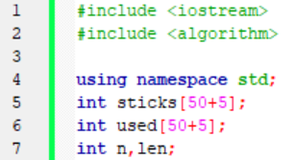
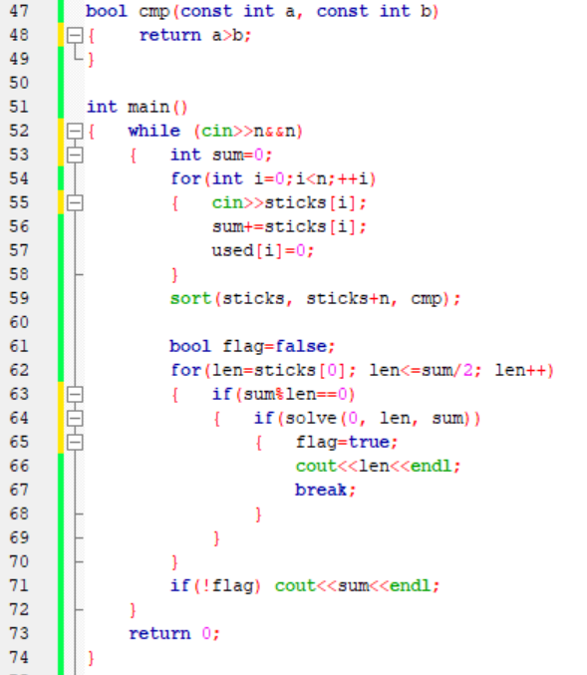
global
variable

Slide 10
